Slide 1
Queues
Chapter 6

Slide 2
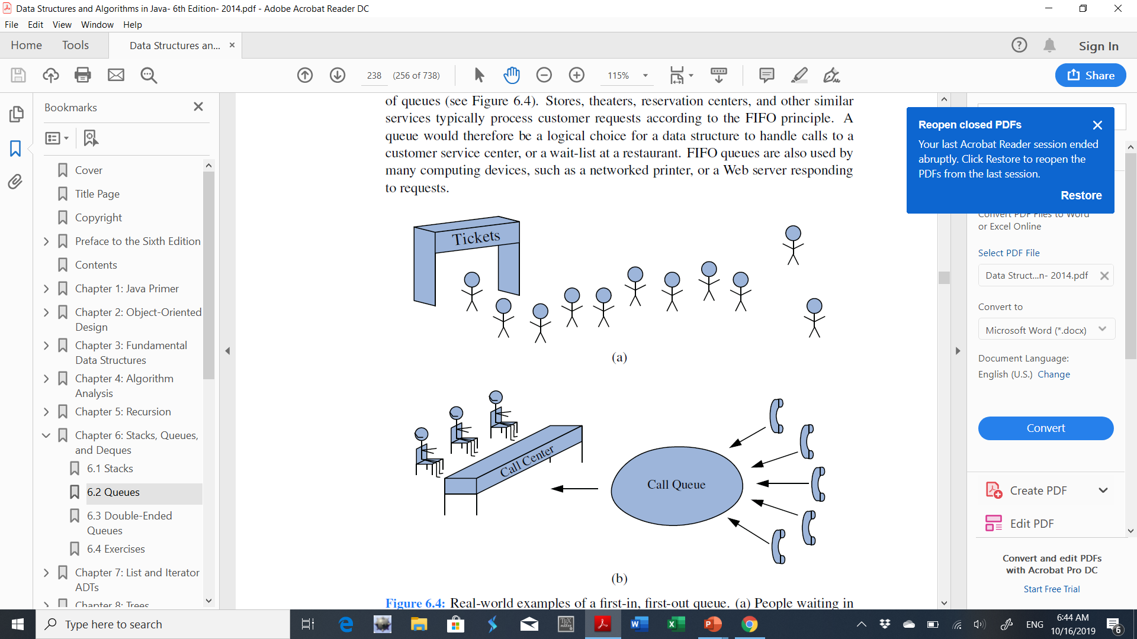
Queue
A queue is a collection of objects that are inserted and removed according to the first-in, first-out (FIFO) principle.
Many applications:
Handle calls to a customer service centre
A wait-list at a restaurant
A networked printer
A Web server responding to requests
10
6
8
9
1
5
7
2
4
11
3
4
6
1
3
5
2
Notes:
Internet Web browsers store the addresses of recently visited sites on a stack. Each time a user visits a new site, that site’s address is “pushed” onto the
stack of addresses. The browser then allows the user to “pop” back to previously visited sites using the “back” button.

Slide 3
The Queue ADT
Main Methods
dequeue
enqueue
Removes and returns the first element from the queue
Adds an element e to the back of queue
Front
Back
Queue
Insertion is done at one end (back or rear).
Deletion is performed at the other end (front or start).

Slide 4
The Queue ADT
Main Methods
enqueue(e): Adds an element e to the back of queue.
dequeue( ): Removes and returns the first element from the queue (or null if the queue is empty).
first( ): Returns the first element of the queue, without removing it (or null if the queue is empty).
size( ): Returns the number of elements in the queue.
isEmpty( ): Returns a Boolean indicating whether the queue is empty.

Slide 5
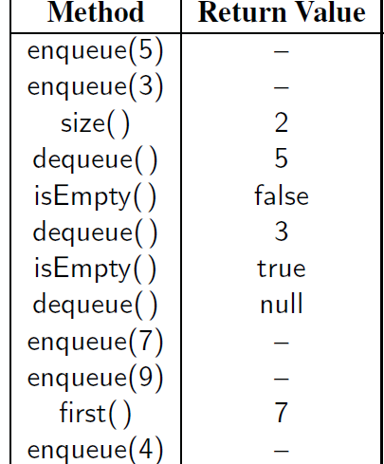
Example
Initial queue Q is empty
Q
5
5 | 3
5 | 3
3
3
Empty
Empty
Empty
7
7 | 9
7 | 9
7 | 9 | 4

Slide 6
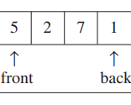
A Queue Model and implementation
For each queue data structure Q, we keep:
the positions front and back, which represent the two ends of the queue.
the number of elements that are in the queue (size).
Implementation:
Linked list-based
Array-based
Q
size=4

Slide 7
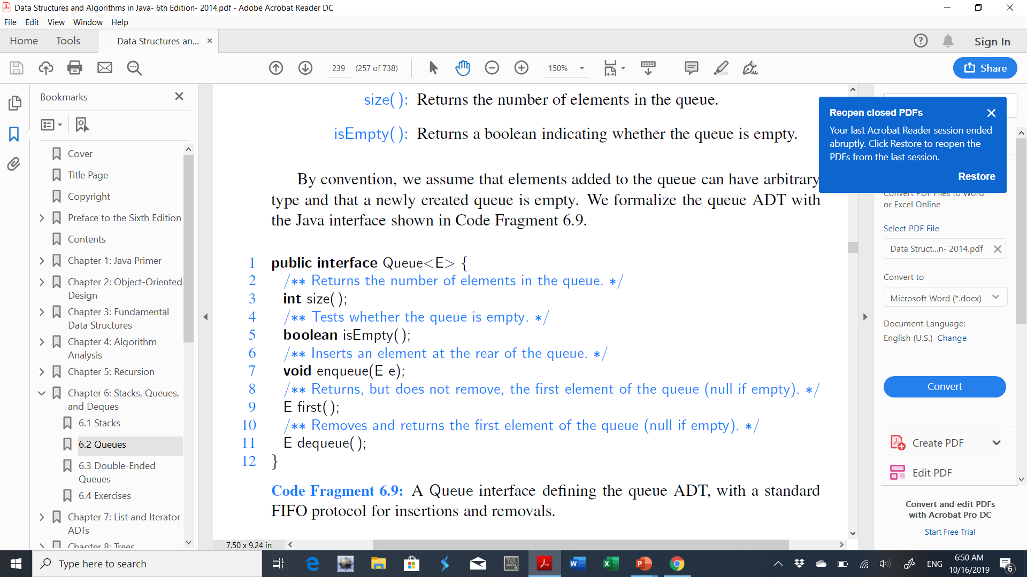
A Queue interface

Slide 8

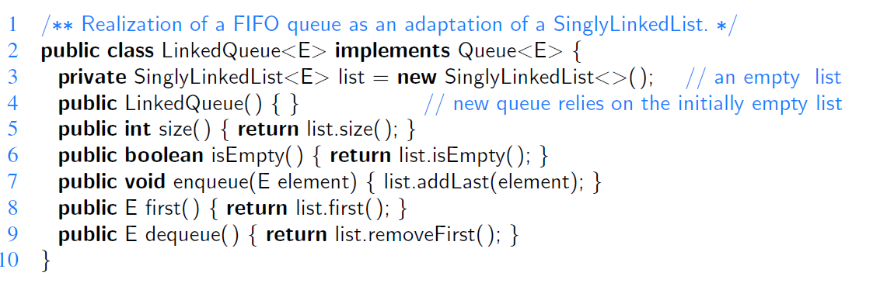
Implementing a Queue with a Singly Linked List
head=front
tail=back
Q
size=5
Each method runs in O(1) worst-case time

Slide 9
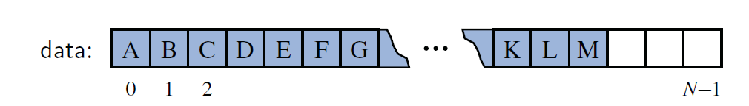
Array-Based Queue Implementation
Store elements (or data) in an array such that the first element is at index 0, the second element at index 1, and so on.
How should we implement the dequeue operation?
The element to be removed is stored at index 0 of the array.
Use a loop to shift all other elements of the queue one cell to the left.
O(n) running time for the dequeue method.
For improvement: avoiding the loop entirely.
Q
Q
Q
10 | 5 | 8 | 12
[0] | [1] | [2] | [3]
5 | 8 | 12
[0] | [1] | [2] | [3]
After dequeue
size=4
front
back=size-1
size=3
front
back=size-1

Slide 10
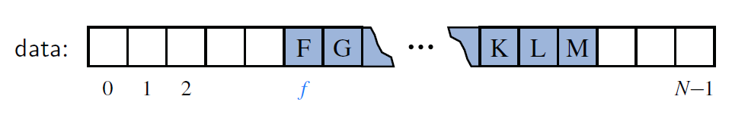
Array-Based Queue Implementation
Another strategy (without using loop):
Replace a dequeued element in the array with a null.
An explicit variable f to represent the index of the element that is currently at the front of the queue.
dequeue would run in O(1) time
What should we do when f reaches the back of the queue?

Slide 11
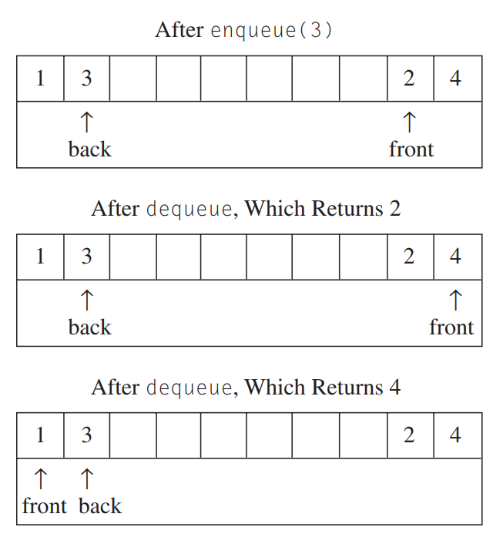
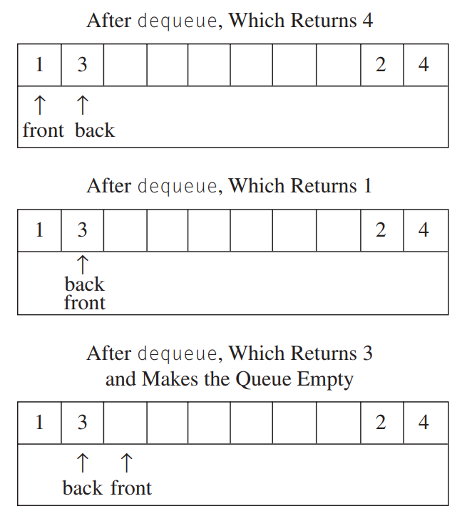
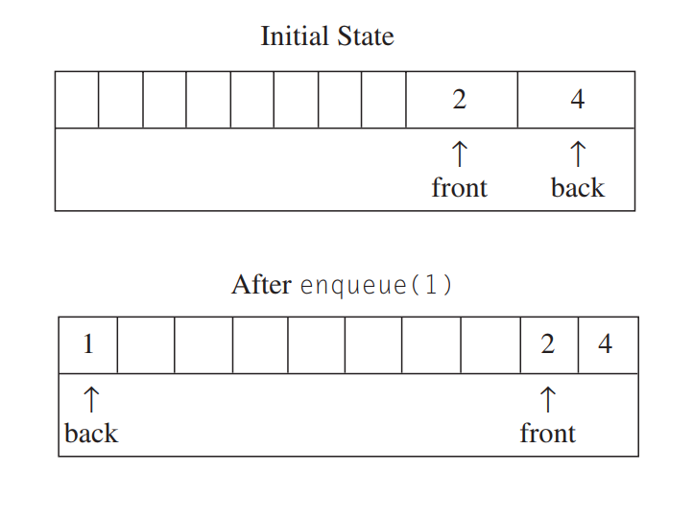
Array-Based Queue Implementation
(3)
(6)
Suppose after some operations, Q:
Array length = 10
(1)
(4)
(7)
(2)
(5)
Update front and back if after step (6)
we enqueue(20).
front
back
= null
* After dequeue: new front index= (front index+1) %array length Ex. front index in (4) = (8+1)%10=9
* After enqueue: new back index=(front index+old size)%array length Ex. back index in (2) = (8+2)%10=0

Slide 12
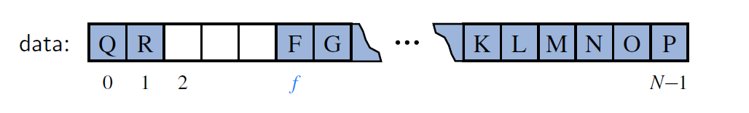
Array-Based Queue Implementation
Using an Array Circularly
Allow both the front and back of the queue to drift rightward.
The modulo operator is ideal for treating an array circularly (i.e., finds correct index).
Dequeue: f = ( f +1) % data.length
Enqueue: available(avail) = (f + size) % data.length where size (or sz) is the number of elements in the queue.
*data.length = array length and available (avail) = new back index

Slide 13
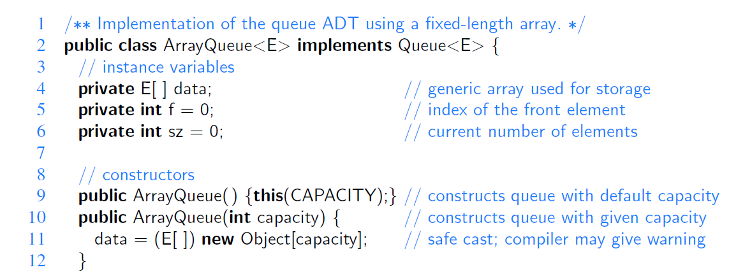
Array-Based Queue Implementation

Slide 14
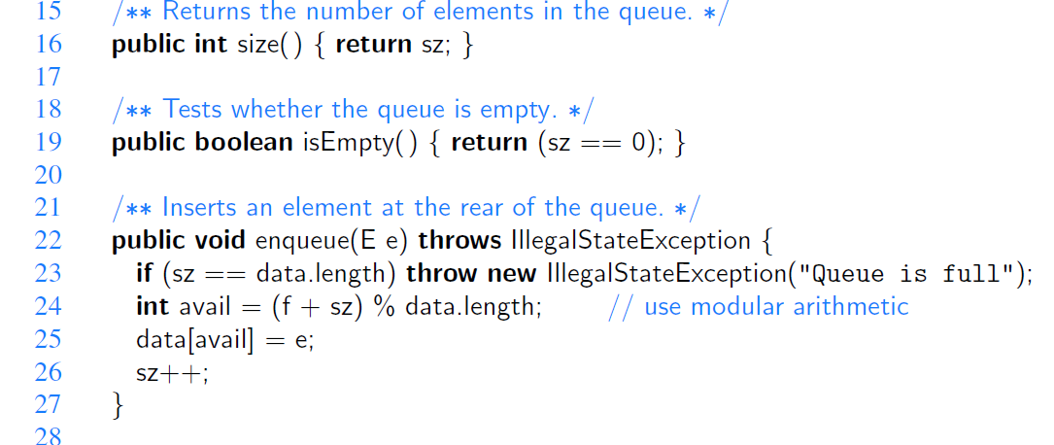
Array-Based Queue Implementation

Slide 15
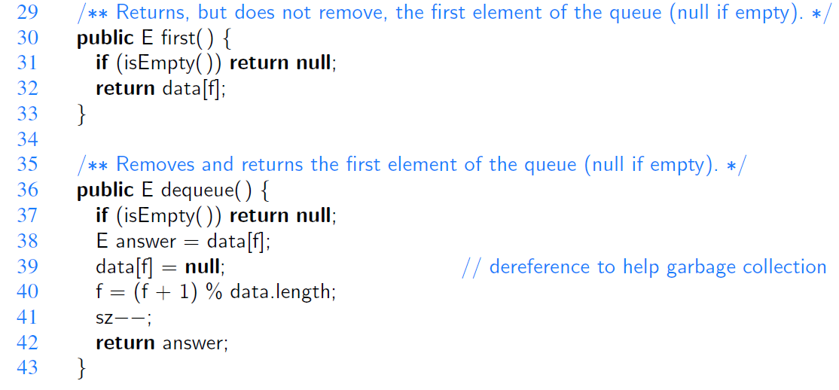
Array-Based Queue Implementation

Slide 16
Worst-case time complexity
Operation | “Circular” Array | “Normal” Array | Linked List (head & tail)
enqueue | O(1) | O(1) | O(1)
dequeue | O(1) | O(N) | O(1)
* N = size

Slide 17
Exercises
A palindrome is a word, phrase, number or sequence of words that reads the same backward as forward, e.g. noon and mom. Given a text, write an algorithm that return 'true' if the text is a palindrome and 'false' otherwise.
Implement String Compress(String S) that compresses a string by deleting all space characters in the string.
Rewrite the class LinkedQueue without using SinglyLinkedList as instance attribute.

